Slide 1
Student Information Management System
Created By:
Paul, Adrian, Edwon, Hoama, Carl

Slide 2
The Project Objective
The Software program has to have the following computerized system to help the university IT department improve and manage their services to track student basic information.

Slide 3
Project Description:
The student information management system deals with all kind of student details, academic related reports, college details, curriculum, batch details and other resource related details too.
It tracks all the details of a student from day one to the end of his course which can be used to reporting purpose, tracking of attendance, progress in the course, completed semester years, coming semester year curriculum details, exams details, project or any other assignment details, final exam result etc.

Slide 4
Management Team:
How many members are in your team?
5 members
Paul: The Chief Programmer
Adrian: Programmer
Edwon: Programmer
Hoama: Programmer
Carl: Programmer

Slide 5
What type of team model is used in this project?
Democratic Team Approach
The project work is equally separated among team members so all team members have a say in how the program will be run and the direction it will be going.

Slide 6
Programming Team:
Paul: The Chief Programmer
It will handle the documentation, programming code, the research and the direction and time frame to meet the programs goals and expectation to satisfied the customer needs.

Slide 7
Programming Team:
Adrian: Programmer
Will focus on documentation and research on the material
Edwon: Programmer
Will focus on research and development in the programming code.
Hoama: Programmer
Will focus on research and development in the programming code.
Carl: Programmer
Will retouch the program and documentation as needed.

Slide 8
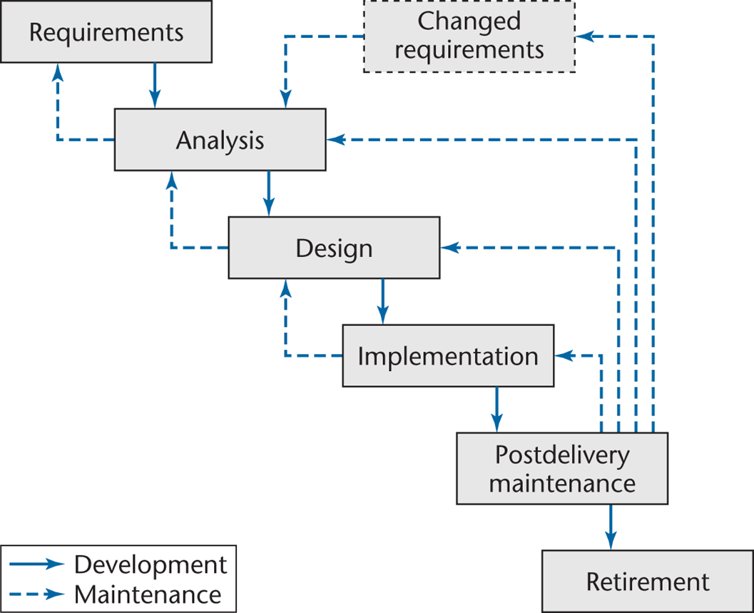
Waterfall Life-Cycle: Model
Waterfall Life-Cycle Model:

Slide 9
Waterfall Life-Cycle: Model
Waterfall Life-Cycle Model:
Definition:
It requires pre-planning and makes the process of development easy because it catches all flaws and errors which are going to occur during the developmental phase and how to handle them efficiently.

Slide 10
Waterfall Life-Cycle: Model
User Requirements:
The software system only stores and retrieves student partial information in the current semester and other basic information:
Student Name
Student ID
Register Course in the Current Semester
Each exam score in one course
GPA Calculation in the current semester

Slide 11
Waterfall Life-Cycle: Model
System and Analysis Specification:
Window 10 software
C++ Programming Code
Visual Studio
Internet Explorer
GitHub

Slide 12
Waterfall Life-Cycle: Design Phase
Business Case Requirement:
Business Case- a justification for a proposed project or undertaking on the basis of its expected commercial benefit.
For the educational institution, to register student quickly and effectively for meeting the academic requirements, institutional fees, and other financial capital.

Slide 13
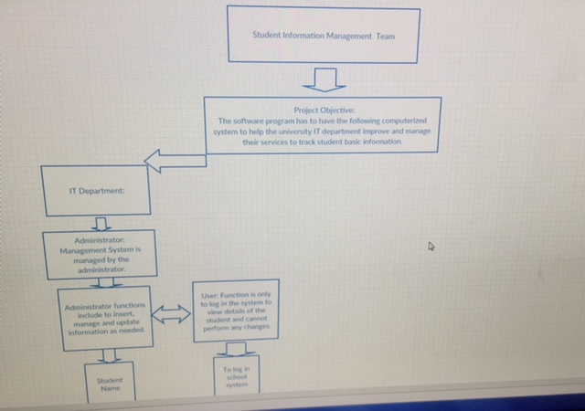
Waterfall Life-Cycle: Design Phase
Design Specification:

Slide 14
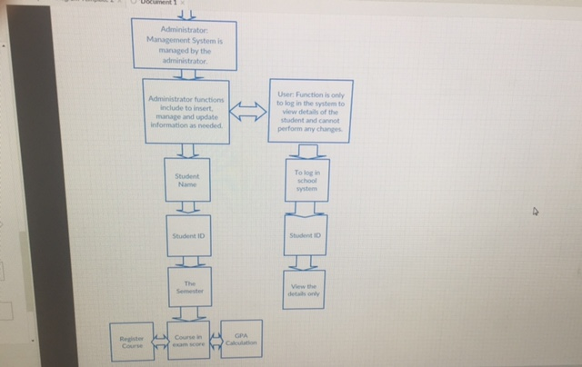
Waterfall Life-Cycle Model: Design Phase
Design Specification:

Slide 15
Waterfall Life-Cycle Model: Use Case Diagrams
Business Model:
An academic institution, computer, monitor, mouse, documentation, academic IT personnel
Customer Model:
Students

Slide 16
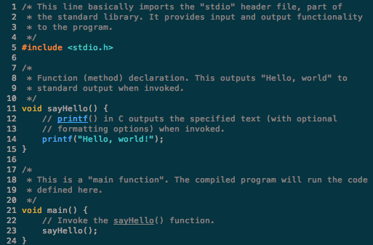
Waterfall Life-Cycle: Website
GitHub
https://github.com/pcortes1987/finalproject.git

Slide 17
The End
Question, comment, concerns?

